Slide 1
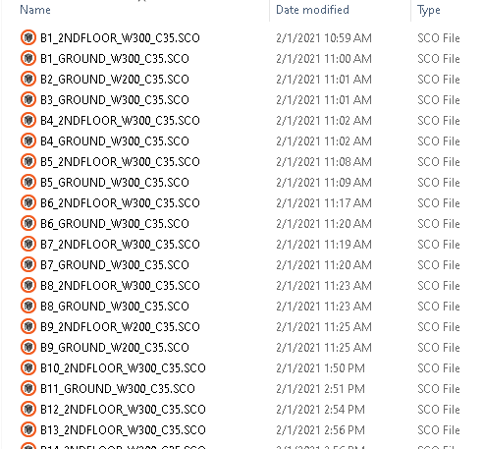


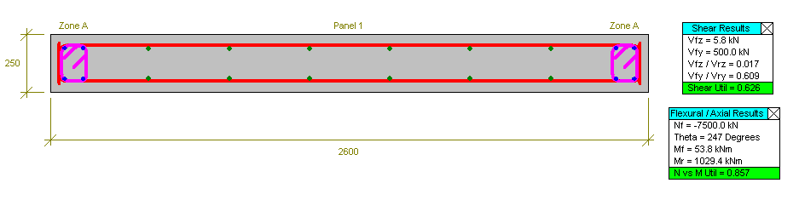


ETABSPY V1.0
+

Slide 2
ETABS 2 S-CONCRETE v1.0
THE CURRENT EXPORT PROCESS
1. User creates the first S-CONCRETE file and “Save As” for subsequent walls.
2. User measures and sets the pier length, pier thickness and story height.
3. User selects the corresponding pier in ETABS.
4. Go to Display > Show Tables.
5. Copy axial, moments and shears into S-Concrete loading table.
Average time per pier per story = 3-5 minutes
A selected 12 story residential building has 397 walls which would have result in 2 to 4 days of work creating the required files with a good chance of mistakes in pasting the loads or setting the correct lengths or thicknesses. The solution is automation!

Slide 3
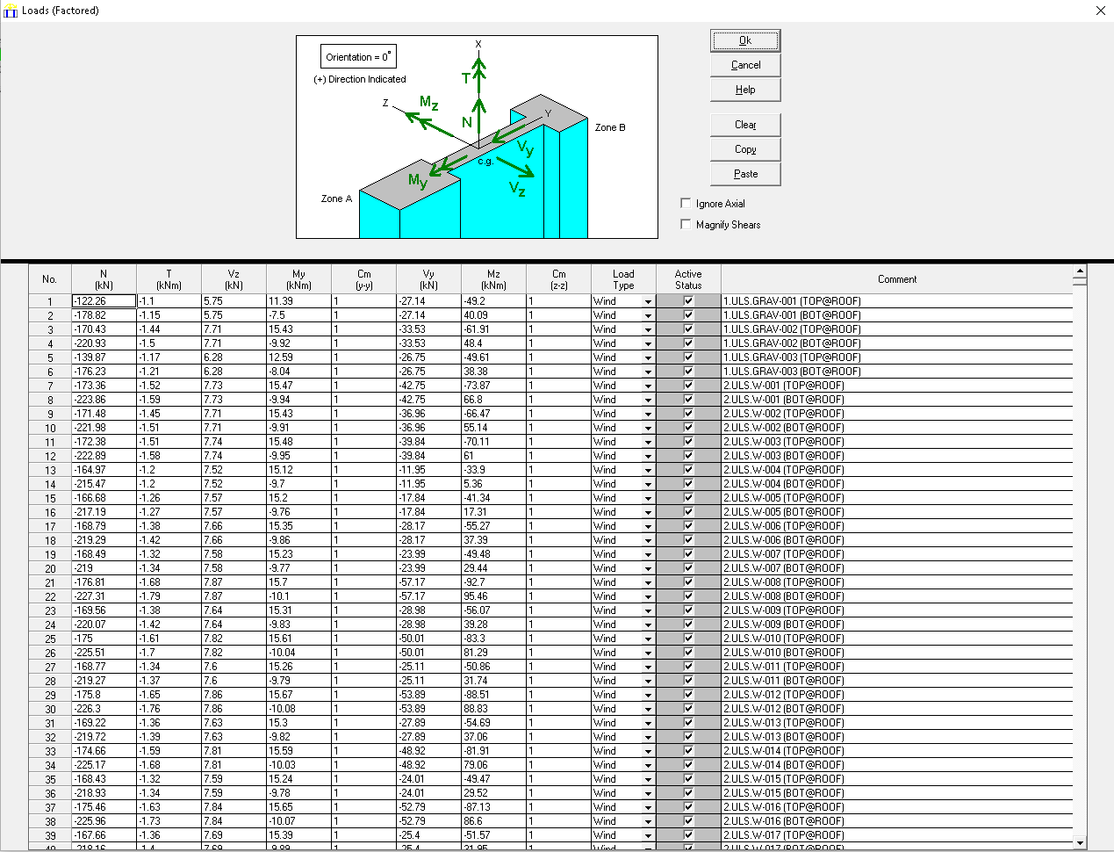
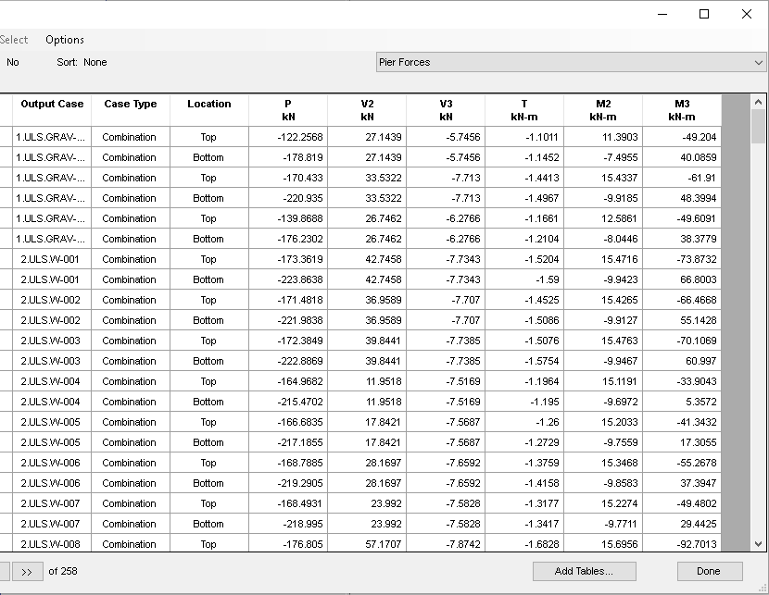
ETABS 2 S-CONCRETE v1.0

Slide 4
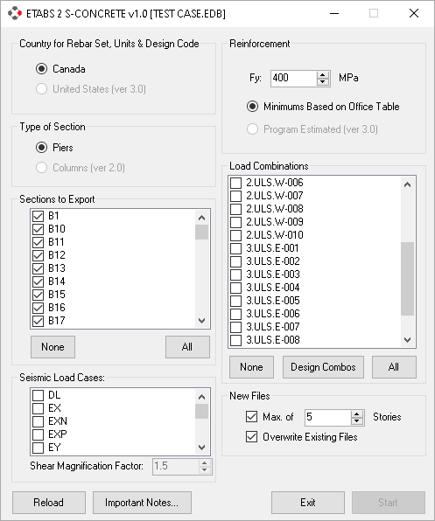
ETABS 2 S-CONCRETE v1.0
USER INTERFACE
2. Select the combinations that you want to be included in the S-CONCRETE files.
1. Select the pier labels that you want to be included in the S-CONCRETE files.
4. By default, this program tries to reduce the number of S-CONCRETE files by making one SCO file for piers that have the same pier label, length, thickness, material and height. This number, if set, will limit the number of stories that will be considered for merging. If unchecked, the program will try to merge as many walls as possible.
3. Select all the seismic cases even if you do not want to magnify them.

Slide 5
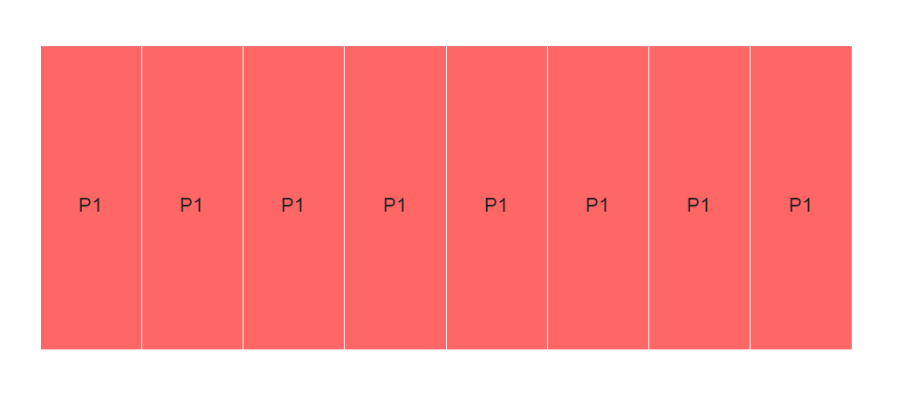
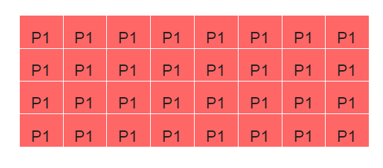
ETABS 2 S-CONCRETE v1.0
MESHED WALLS
The program has the capability of recognizing meshed walls as one single wall if they all have the same pier label.

Slide 6
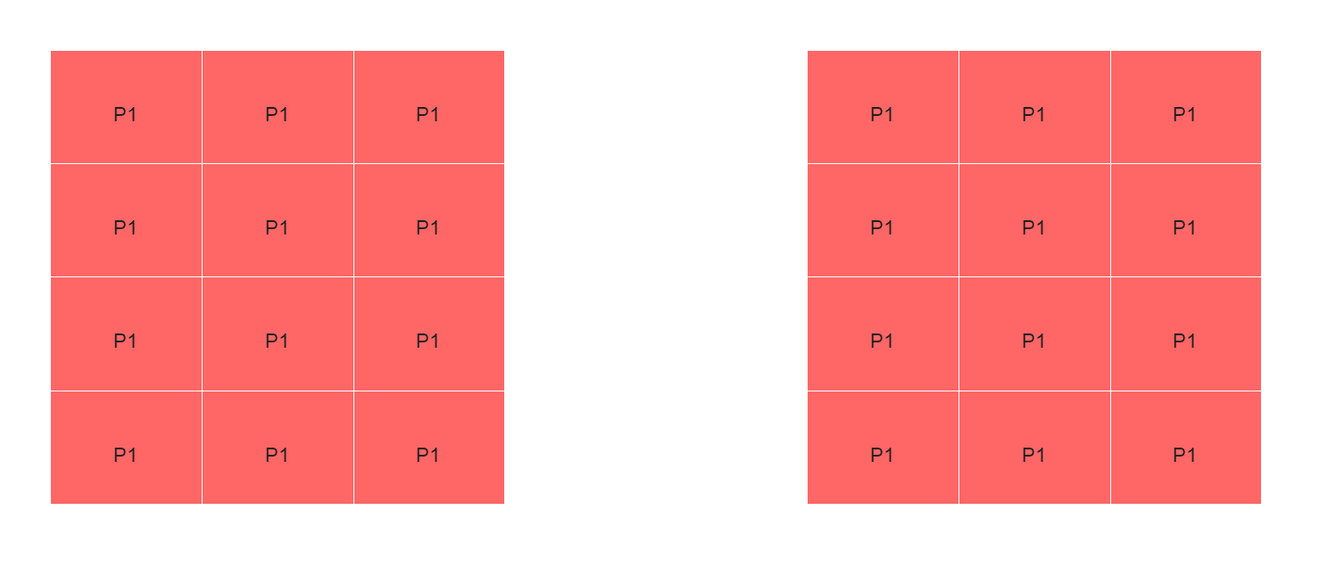
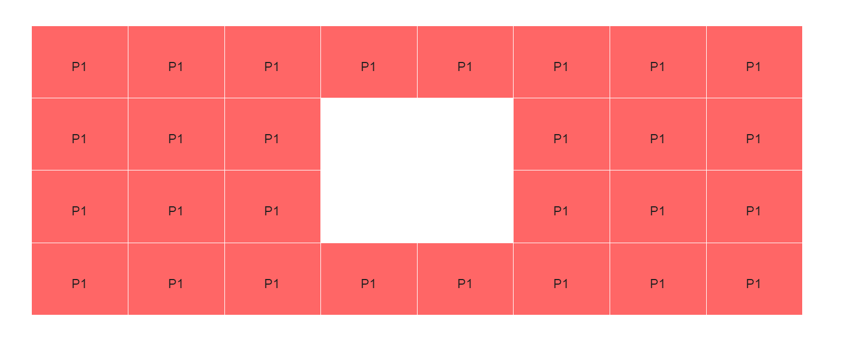
ETABS 2 S-CONCRETE v1.0
SOME SCENARIOS
Pier assignments have to be as per the general guidelines. Only straight piers are supported.
r
ri
Separate walls should have different pier labels
Separate pier labels may be required
ari

Slide 7
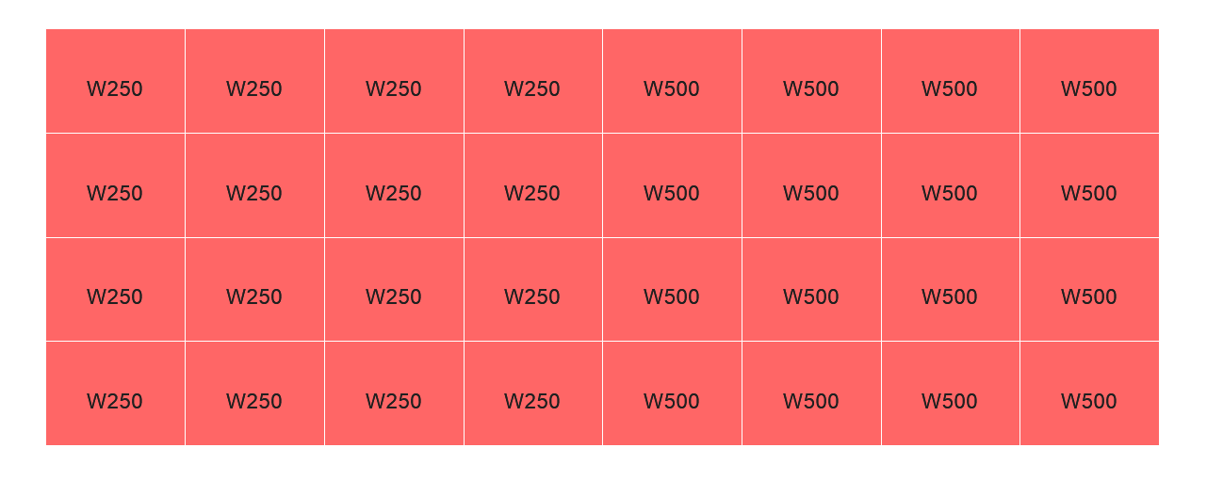

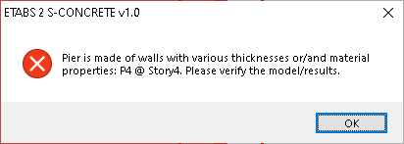
ETABS 2 S-CONCRETE v1.0
SOME SCENARIOS
r
r
Overlapped walls with the same pier will be ignored
Separate piers are needed for walls with multiple thicknesses or materials
ari

Slide 8

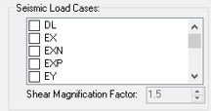
ETABS 2 S-CONCRETE v1.0
WALL GROUPING
This program is capable of reducing the number of S-CONCRETE files by grouping walls that have the same pier labels, lengths, thicknesses, materials and story heights into one S-CONCRETE file. This feature is ON by default for groups of 3 story at a time but can be changed to 1 (means no merging) or being unchecked (max number of walls to be merged). Note: The program does not check if walls are actually stacked up or not.
SHEAR MAGNIFICATION
Unlike our general seismic magnification combos that magnify all components of seismic load cases (P, M and V), this program allows the user to magnify the shear components (V2 and V3) only. For cases where user wants to include “4. ULS.E.MAG-XXX” combos in the export, the user should be careful of not over magnifying these combinations.

Slide 9
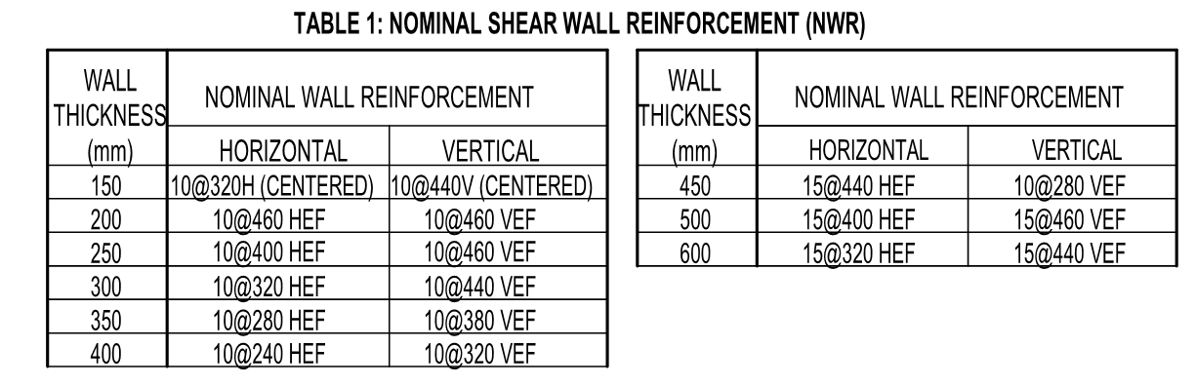
ETABS 2 S-CONCRETE v1.0
REINFORCEMENT

Slide 10
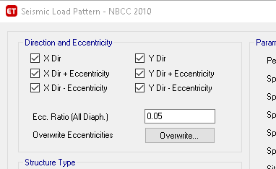
ETABS 2 S-CONCRETE v1.0
LIMITATIONS
Unbraced length of walls are always set to the story height. If a wall has a higher unbraced length, user should manually adjust the value in the created S-CONCRETE files.
Only load combinations that are ‘Linear Add’ can be selected. For example, envelope load combinations are not supported.
Currently, nested combinations are not supported. For example, a load combination cannot include another load combination.
Only ‘Linear Static’ and ‘Response Spectrum’ cases are supported as load cases inside a combination.
Multi-step static load patterns are not supported in this version.

Slide 11
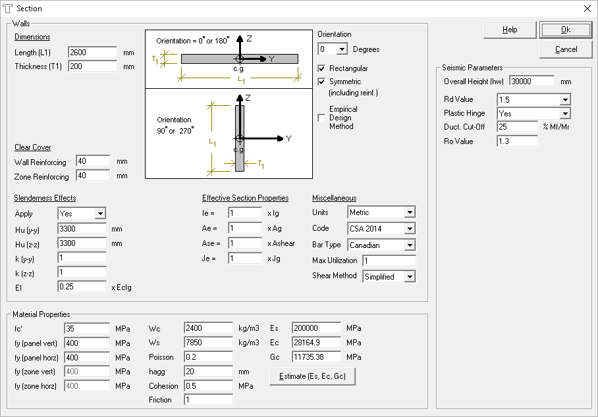
ETABS 2 S-CONCRETE v1.0
LIMITATIONS

Slide 12
ETABS 2 S-CONCRETE v1.0
FUTURE IMPROVEMENTS
Support for ETABS v19
Support for Imperial units, rebar size, and minimum rebar.
Customizable end zone rebar. Currently, it provides 4-15M bars by default.
Multiple Tower Options
Selectable Story Range
If the minimum rebar seems insufficient, the program can increase (estimated) the rebar in the created S-CONCRETE files and provide a list of those walls to the user.
Export of ETABS columns to S-CONCRETE
Any Suggestions or feedbacks?

